Slide 1
SS ZG653: Software Architecture Lecture 16: Architecture of Next Gen Systems
Instructor: Prof. Santonu Sarkar
March 31, 2015

Slide 2
Cloud Computing Paradigm

Slide 3
Characteristics of Cloud Computing
According to
National Institute of Standard & Technology
On Demand and Self-Service
Consumer can provision the computing resource without provider’s intervention
Ubiquitous Access
Resource can be accessed through network on heterogeneous platforms
Location independent access
Resource Pooling
Internally resource needs to be pooled and shared among consumers
Elasticity
Rapid and elastic scale up/down of resource
Measured Service
Monitoring and measuring of service
Multi-tenancy
Single application to support distinct class of users
Each class has its own dataset and access rights

Slide 4
Service Oriented Software- Characteristics
Cloud Computing
Next Generation of Service
Consumer can provision the computing resource without provider’s intervention
Resource can be accessed through network
Internally resource needs to be pooled and shared among consumers
Rapid and elastic scale up/down of resource
Monitoring and measuring of service
On demand
Self-serviced & personalized
Multi-tenancy (better resource consumption)
Rapid scaling
Affordable mode of payment
Always available through any client platform
Continuous adaptation
Ensure accountability and trust

Slide 5
Four Key Infrastructure Components
Infrastructure Sharing
Provisioning of right sized infrastructure on-demand
Customers and providers form a larger ecosystem
Emergence of social network
Customers decide the feature
Virtualized Infrastructure
Social
Mobile
Analytics
Prolific adoption of mobile devices
Increase in mobile compute power
Next gen services will mobile device for service consumption
Massive data
From infrastructure
From social ecosystem
Next gen service will process and analyze this data for its own evolution

Slide 6
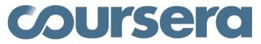








Examples
170 million Gmail users. Two major failures in Dec 2012 when Gmail upgraded its attachment capability to 10GB.
In 2012, > 200 courses, 33 universities, 1.9M students accessing video/audio lectures and presentation
Sep 2012- effected by DDOS attack
100M users, 100 PB
All of their user files were publicly accessible for 4 hrs due to authentication fault
185,000 applications on Force.com
6M Txn/day
1B active users, 500M uses mobile devices
500M active users, handles 1.6B queries per day
1B Txn/day.
They need to detect credit card fraud within 5ms.
8 petabytes/yr, 20hrs of new video/min

Slide 7
Data Deluge- structured, unstructured text, audio, and video
Next Gen Service uses various means to interact with its environment
Sensors in various form
Users connected via wired and wireless network
Create, share and communicate information among the service community- subscriber, provider, manufacturer
Data is massive
1800 exabyte today-- of which 70% is created by individuals
Facebook → more than 30 petabytes of user content
amazon → petabytes of user-reco & browsing data for recommendation
Unprecedented Impact
Informed and near optimal decisions on all relevant aspects of the service
Service offering, product design can be improved through realtime feedback
Distribution, production and maintenance can be highly fine tuned
Empowers consumers like never before
Scenarios
US Healthcare can save upto 300B through informed decision making
Europe govt admin service can save € 100B through operational efficiency in tax collection
Personalized suggestions, optimized real-time pricing – Amazon
(http://www.emc.com/collateral/analyst-reports/diverse-exploding-digital-universe.pdf)
(http://hmi.ucsd.edu/pdf/HMI_2009_ConsumerReport_Dec9_2009.pdf),
(http://www2.sims.berkeley.edu/research/projects/how-much-info-2003/printable_report.pdf)
http://www.mckinsey.com/mgi/publications/big_data/index.asp
http://www.reuters.com/article/2011/07/19/idUS319973276120110719

Slide 8
Traditional versus Cloud Computing (Layered Rubric)
Client (presentation and devices)
Client (presentation and devices)
Software As a Service
Application
Service
Application
Platform As a Service
Application Framework, Middleware
Database
Service
Application Framework, Middleware, Database
Process
Computing Infrastructure (HW/SW)
Infrastructure As a Service
Process
OS
OS
Virtual Hardware
Virtual Hardware
Physical Hardware
Physical Hardware

Slide 9
Cloud Computing - Examples
Mobile- Andriod, iPhone, Windows Mobile
OS- gOS
Thin client- Zonbu, gOS based applications
Software As a Service
Identity : OAuth, OpenID
Integration : Amazon Simple Queue
Payments :Amazon Flexi Pay, PayPal
Mapping : Google Maps
Search :Google Custom Search, Yahoo! BOSS
Human: Mechanical Turk
Peer-peer : Skype, Bittorent
Web app : Facebook
SaaS: Google Apps, SAP, Salesforce
Microsoft Online service
Platform As a Service
Database :Amazon SimpleDB, Google BigTable
Network : MobileMe iDisk, CloudNAS
Synch : MobileMe push
App Framework: Google App Engine, Ruby on Rails
.NET : Azure Services Platform
Proprietary : Force.com
Infrastructure As a Service
Full virtualization (GoGrid, Skytap)
Grid computing (Sun Grid, HP)
Management (RightScale, Elastra, HP)
Compute (Amazon Elastic Compute Cloud)

Slide 10
System Virtualization
Virtual Machine Monitor (VMM) - Hypervisor
Underlying software platform that provides virtualization support
Manages several VMs
Two main services
Page mapping
Scheduling
Virtual machine
A software that simulates a machine environment
Guest Operating System
An operating system and its applications running inside a VM
Physical hardware
Hypervisor (VMM)
VM1
VM2
VM3
Ubuntu
Redhat
Windows
Application
Application
Application
Application
Application
Application
10

Slide 11
Hypervisor
According to [1], a VMM should have
Equivalence
Efficiency
Resource Control
Furthermore a VMM provides
mediation between VM and hardware
Strong isolation (performance, fault and security)
encapsulation of virtual machine
Failure and recovery (Reliability)
Check pointing (Reliability)
Live migration (Availability)
1. G. J. Popek and R. P. Goldberg, "Formal Requirements for Virtualizable Third generation Architectures," Communications of ACM, vol. 17, no. 7, 1974

Slide 12
Virtualization Basics- Memory Mgmt
Memory divided into pages- some are in physical memory and the rest are in disk (swap)
Page table maps consumer application address to machine address or disk location
Virtualized Environment
VM page table maps target address to an address within VM.
This is converted to physical address by Hypervisor page table

Slide 13
Network- in a Nutshell
Recall every device, and a VM on a network can have its own IP address (32bit number for IPv4)
IP message has a header (source IP addr, destination IP addr) and the content
IPv6 has 128 bit header but it has source and destination IP
Gateway
An organization uses a gateway to manage incoming and outgoing traffic
Public IP: www.google.com (unique within internet)
Private IP: restricted within the organization (10.2.1.1)

Slide 14
Network Address Translation (NAT)
Outgoing message
Gateway records the private IP of the source, replace the header with its own public IP
Sends it to external network
Incoming message
Gateway intercepts, overwrites the destination IP (which is the gateway) with internal private IP
Sends it to internal network

Slide 15
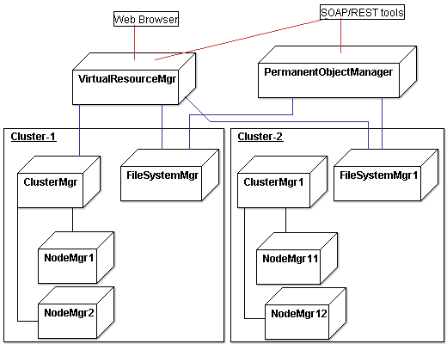
Infrastructure as a Service
Variety of clusters
A cluster manager manages node, and persistent object manager manages files
Cluster manager controls
execution of VMs on a node
Virtual networking between VMs and VM– external user
Node manager uses the hypervisor to manage VM execution, inspection, and termination

Slide 16
Networking in IaaS
Virtual Resource Manager acts as a Gateway
If a VM has a public IP address, IaaS automatically reallocates this to another VM if this VM fails
Auto Scaling
On demand, based on the workload, new VMs can be spawned

Slide 17
Data (Massive) and Storage
Forces against Traditional RDBMS
Billions of pages need to be collected and indexed. The data access is through simple indexes, sophisticated RDBMS indexing and optimization is not required
Data schema is not fixed
To get data from multiple table, join is required which is expensive when data is large
It is okay to have temporary inconsistency of data, but availability is a MUST

Slide 18
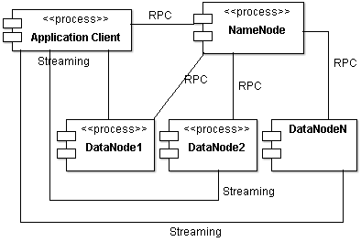
HDFS
One NameNode managing multiple DataNodes
Data stored in DataNodes in blocks of 64MB
Each block is replicated for Reliability
Component and Connector View

Slide 19
HBase
Hbase- key-value based database like Google’s BigTable
Trillions of data can be stored
Supports table but no schema, one column is key
A data-value is indexed by
Row value, column name, timestamp
Supported time based versioning
Web page crawling
Row value can be URL
Columns can be attributes of web-page
URL/timestamp can be the index

Slide 20
MongoDB
Stores data as object- containing all information about some concept
Without bothering whether a data field of one object is related to another object
Two objects can have all data fields common, some common or no commonality
Links in data items can serve as connection between object implicity…
Stored in binary JSON
A field may be indexed or not indexed. No concept of primary or secondary keys

Slide 21
Quality of Service
Architecting a system meant for cloud platform is no different from other distributed platform
Issues of modifiability, interoperability, and testability are the same
What’s significantly different
Availability
Performance
Security

Slide 22
Availability
Services expected to always available- but there are many failure points
VM, PM, Network
Architect should plan for a failure
EC2 provides 99.95% availability, but how to plan for 0.05% failure?
Netflix – real time video streaming service
hosts on EC2 with additional application level availability
EC2 has 4 days of sporadic outage in 2011, but Netflix was unaffected

Slide 23
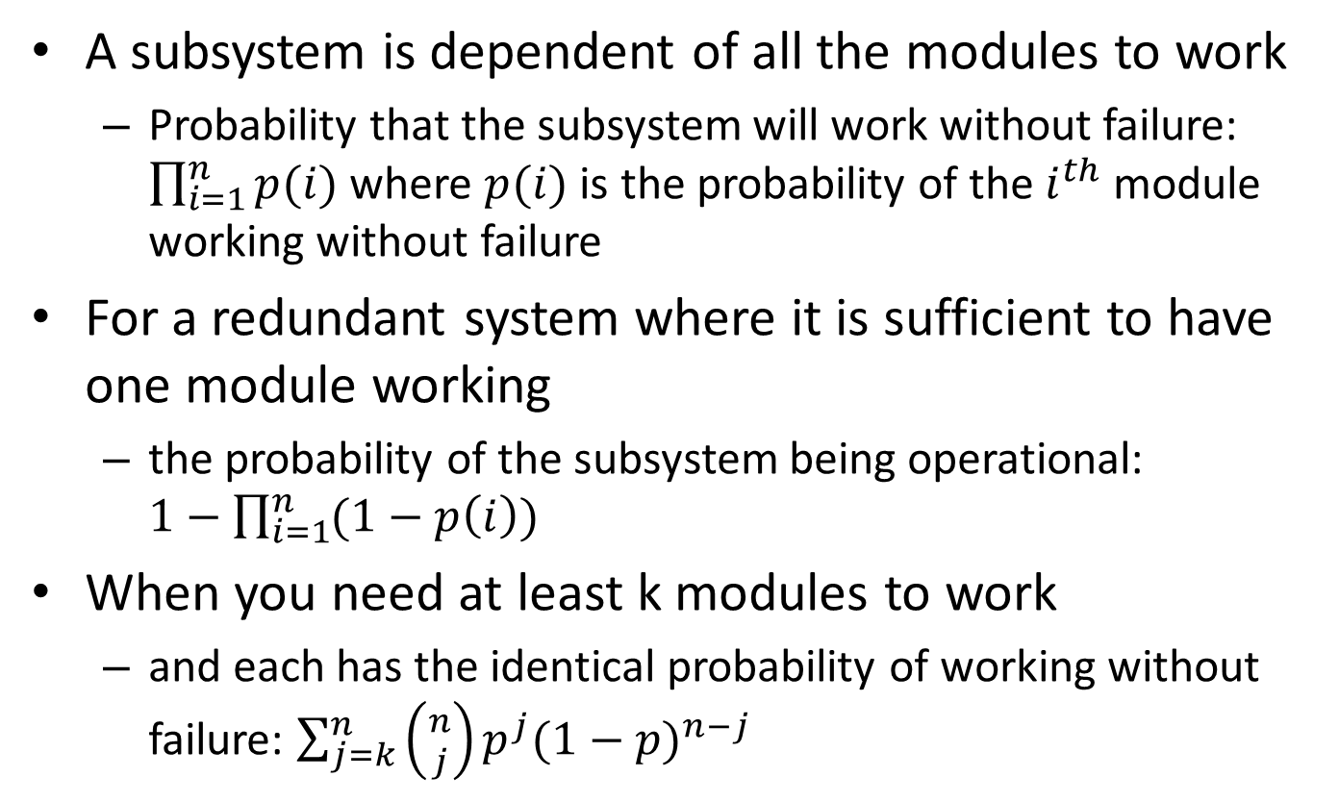
Failure Estimation
A subsystem is dependent of all the modules to work
Probability that the subsystem will work without failure: $\prod_{i=1}^{n}{p(i)}$ where $p(i)$ is the probability of the $i^{th}$ module working without failure
For a redundant system where it is sufficient to have one module working
the probability of the subsystem being operational: $1−\prod_{i=1}^{n}{(1−p\left(i\right))}$
When you need at least k modules to work
and each has the identical probability of working without failure: $\sum_{j=k}^{n}{\left({n \atop j}\right)p^{j}{(1−p)}^{n−j}}$

Slide 24
Netflix case study- Availability
Spare Copy tactic
Use of stateless service- any service request can be executed by any available server
Thus everyone can be a spare copy!
Active redundancy tactic
Amazon’s availability zone: Multiple redundant hot copies of data spread across Amazon provided availability zone
Graceful degradation tactic
Fail fast- use timeout so as to isolate from a failing component
Fallback- critical services degrade to a lower quality representation (similar to OS)
Feature removal- non-critical features are removed from being used

Slide 25
Performance
Assurance of business transaction SLA
Cloud can elastically add additional resource
Increase the VM capacity on-demand
Add additional VMs to divert the load
As an architect
It is necessary to understand Application’s resource demand and projected resource usage
Application should predict the load and possibly ask for more resource from the cloud resource manager

Slide 26
Security
Multi-tenancy in Cloud can increase security threat possibility
A PM is hosting other VMs alongwith yours
Information stealing
Each tenant’s virtual resource is ultimately mapped to a physical resource. Data from one tenant’s physical resource can get copied/moved to another tenant
VM escape
Though rare, an attacker can exploit hypervisor software error and access information by accessing VM address space
Side channel attack
Attacker can deduce the information about keys and other data by monitoring timing activity of another VM
Denial of Service
Malicious tenant grabs maximum resources so that other VMs starve for resource and that impacts service quality

Slide 27
Testing strategy Netflix- Simian Army
Uses test environments (called monkeys) to test
Latency: induces artificial delays in the communication to simulate service degradation and measures impact
Fault-Injection: Injects faults at several places of a running system to analyze the fault-tolerance
Helper utilities
Conformity: checks if a VM instance don’t adhere to best practices and shuts it down
E.g. Security: detects security violations or improper configuration
Improper configuration of security group, use of SSL, use of DRM
Health: monitors CPU load to detect overloaded VMs
Janitor: Removes unused resources

Slide 28
CAP Theorem
No distributed system can achieve all of the three properties
Consistency
The data will be consistent throughout the distributed system
Availability
The data will always be available
Partition Tolerance
The system will not fail when network is partitioned

Slide 29
CAP Theorem- Explanation
Imagine a distributed system which keeps track of a single piece of data using three nodes—A, B, and C—and which claims to be both consistent and available. Misfortune strikes, and that system is partitioned into: {A,B} and {C}. Now a write request arrives at C.
Accept the write, knowing that neither A nor B will know about this new data until the partition heals.
Refuse the write, knowing that the client might not be able to contact A or B until the partition heals.
Choosing Consistency Over Availability
It has to guarantee atomic reads and writes by refusing to respond to some requests. It may decide to shut down entirely (like the clients of a single-node data store), refuse writes (like Two-Phase Commit), or only respond to reads and writes for pieces of data whose “master” node is inside the partition component
Choosing Availability Over Consistency
It will respond to all requests, potentially returning stale reads and accepting conflicting writes. These inconsistencies are often resolved via causal ordering mechanisms like vector clocks and application-specific conflict resolution procedures.
Dynamo systems usually offer both of these
Cassandra’s hard-coded Last-Writer-Wins conflict resolution being the main exception

Slide 30
Architect’s Decision
How do we tradeoff between C, A, and P?
Eventual Consistency
Nodes across partitions are allowed to be inconsistent- for some time- then it becomes consistent
Architect’s decision- Design challenge
No more than n% of data should be stale
It shouldn’t take more than t sec. to be consistent
Availability and Partition tolerance (latency) is preferred than consistency
Facebook user should always be able to respond but they are okay with delayed newsfeed
Amazon shopping cart does not require ACID property
Twitter timelines may be delayed
Fund-transfer between Banks- delay of 24hrs is okay

Slide 31
Architect’s Role
Mechanism for eventual consistency
Caching, replication, message retry, timeout
Quality Attribute Tradeoff
NoSQL databases must trade-off between
Availability, latency, consistency , partitioning
Additionally
Interoperability, security

Slide 32
Thank You

